Slide 1
# Adding the input layer and the first hidden layer
## A number of nodes in hidden layers (i.e., units) is (11+1)/2=6
## Initialize the weights as small numbers close to zero
## Use the rectifier activation function (i.e., relu)
## Define a number of input dimensions
classifier.add(Dense(units = 6, kernel_initializer = 'uniform', activation = 'relu', input_dim = 11))
# Adding the second hidden layer
## A number of nodes in hidden layers (i.e., units) is (11+1)/2=6
## Initialize the weights as small numbers close to zero
## Use the rectifier activation function (i.e., relu)
classifier.add(Dense(units = 6, kernel_initializer = 'uniform', activation = 'relu'))
# Adding the output layer
## A number of nodes in output layer (i.e., units) is 1
## Initialize the weights as small numbers close to zero
## Use the sigmoid activation function (i.e., sigmoid)
classifier.add(Dense(units = 1, kernel_initializer = 'uniform', activation = 'sigmoid'))
# Compiling the ANN
##
classifier.compile(optimizer = 'adam', loss = 'binary_crossentropy', metrics = ['accuracy'])
# Fitting the ANN to the Training set
classifier.fit(X_train, y_train, batch_size = 10, epochs = 100)
# Model vizualization
print(classifier.summary())
# Part 3 - Making predictions and evaluating the model
# Predicting the Test set results
y_pred = classifier.predict(X_test)
y_pred = (y_pred > 0.5)
# Making the Confusion Matrix
from sklearn.metrics import confusion_matrix
cm = confusion_matrix(y_test, y_pred)
# Import the pandas library and split a dataset into a ndarray and array
import pandas as pd
dataset = pd.read_csv('Churn_Modelling.csv')
X = dataset.iloc[:, 3:13].values
y = dataset.iloc[:, 13].values
# Encoding categorical data
from sklearn.preprocessing import LabelEncoder
labelencoder_X_1 = LabelEncoder()
X[:, 1] = labelencoder_X_1.fit_transform(X[:, 1])
labelencoder_X_2 = LabelEncoder()
X[:, 2] = labelencoder_X_2.fit_transform(X[:, 2])
from sklearn.preprocessing import OneHotEncoder
onehotencoder = OneHotEncoder(categorical_features = [1])
X = onehotencoder.fit_transform(X).toarray()
X = X[:, 1:]
# Splitting the dataset into the Training set and Test set
from sklearn.model_selection import train_test_split
X_train, X_test, y_train, y_test = train_test_split(X, y, test_size = 0.2, random_state = 0)
# Feature Scaling
from sklearn.preprocessing import StandardScaler
sc = StandardScaler()
X_train = sc.fit_transform(X_train)
X_test = sc.transform(X_test)
# Importing TensorFlow and the Keras libraries and packages
import tensorflow
import keras
from keras.models import Sequential
from keras.layers import Dense
# Initialising the ANN
classifier = Sequential()

Slide 2
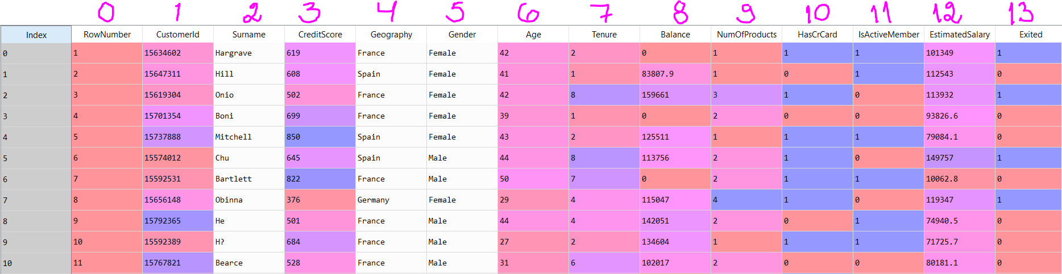
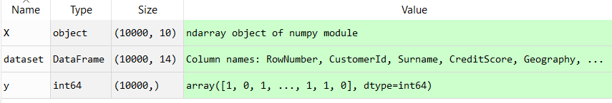
A dataset is Churn_Modelling.csv
“pandas is an open source, BSD-licensed [Berkeley Software Distribution] library providing high-performance, easy-to-use data structures and data analysis tools for the Python programming language . . . the pandas data structures [Series and DataFrame] is as flexible containers for lower dimensional data. For example, DataFrame is a container for Series, and Series is a container for scalars. We would like to be able to insert and remove objects from these containers in a dictionary-like fashion.” (https://pandas.pydata.org/pandas-docs/stable/overview.html#)
“An ndarray is a (usually fixed-size) multidimensional container of items of the same type and size” (https://docs.scipy.org/doc/numpy-1.13.0/reference/arrays.ndarray.html).
import pandas as pd
dataset = pd.read_csv('Churn_Modelling.csv')
X = dataset.iloc[:, 3:13].values
y = dataset.iloc[:, 13].values

Slide 3
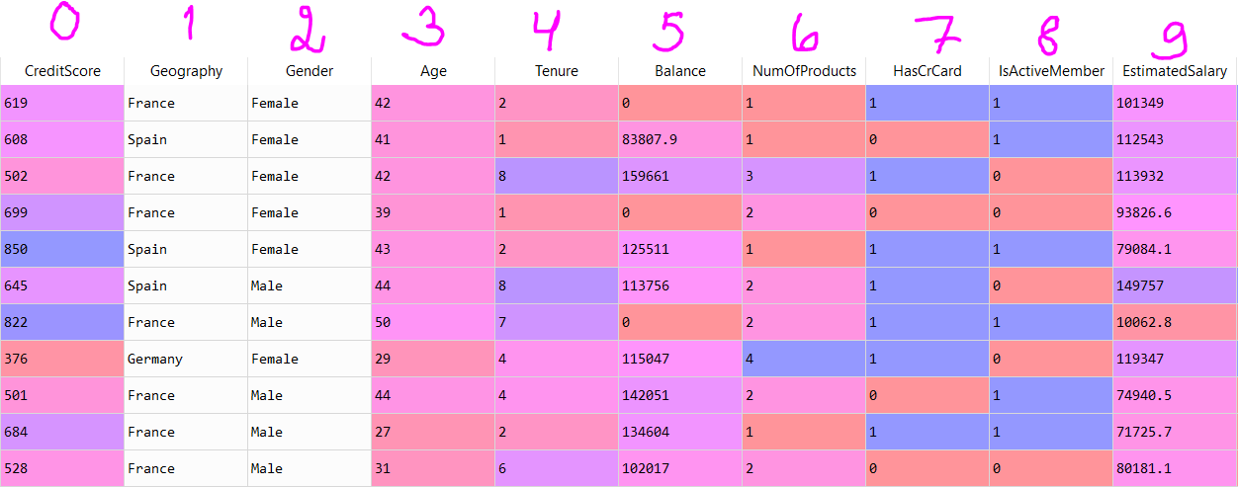
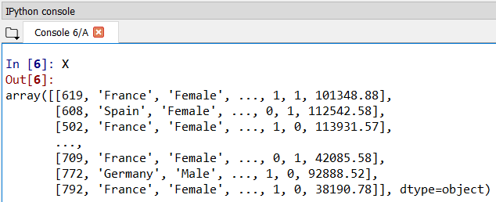
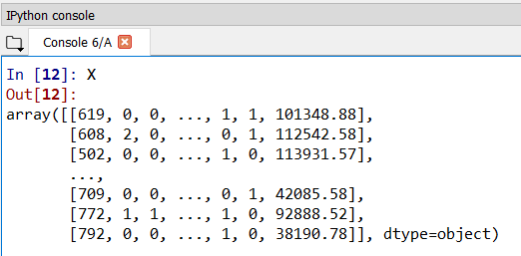
Encode labels with value between 0 and n_classes-1. Fit label encoder and return encoded labels
from sklearn.preprocessing import LabelEncoder
labelencoder_X_1 = LabelEncoder()
X[:, 1] = labelencoder_X_1.fit_transform(X[:, 1])
labelencoder_X_2 = LabelEncoder()
X[:, 2] = labelencoder_X_2.fit_transform(X[:, 2])

Slide 4
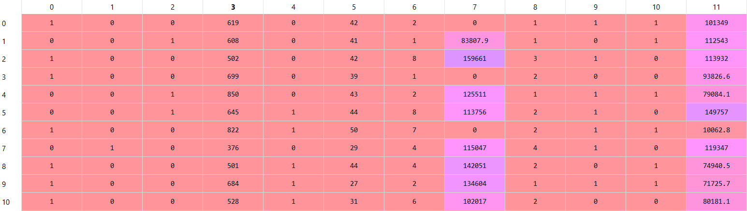
Convert a nominal variable (i.e., a categorical variable the values of which are unordered) into a dummy/indicator variable.
Convert categorical features to features that can be used with scikit-learn estimators by using a one-of-K or one-hot encoding. The OneHotEncoder estimator transforms each categorical feature with m possible values into m binary features.
from sklearn.preprocessing import OneHotEncoder
onehotencoder = OneHotEncoder(categorical_features = [1])
X = onehotencoder.fit_transform(X).toarray()
Geography

Slide 5
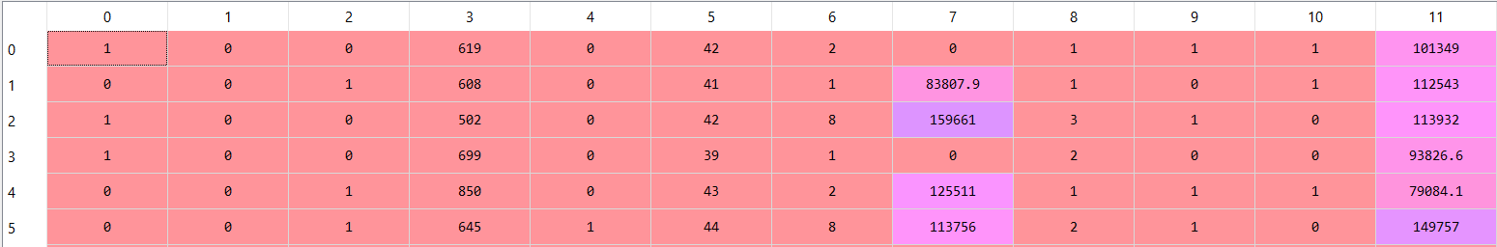
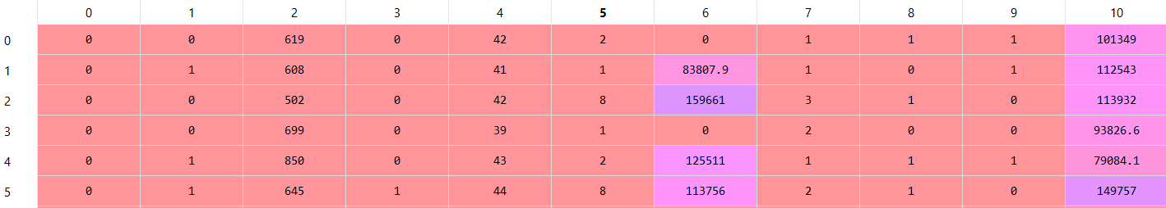
The dummy variable trap “can be avoided by removing either the constant term or one of the offending dummies. The removed dummy then becomes the base category against which the other categories are compared.” (https://en.wikipedia.org/wiki/Dummy_variable_(statistics))
X = X[:, 1:]

Slide 6
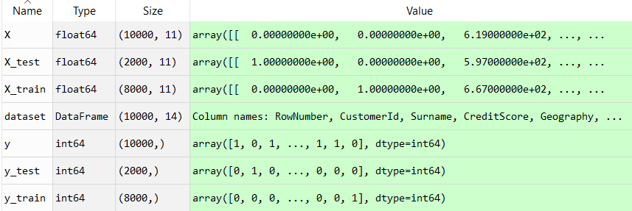
“Learning the parameters of a prediction function and testing it on the same data is a methodological mistake: a model that would just repeat the labels of the samples that it has just seen would have a perfect score but would fail to predict anything useful on yet-unseen data. This situation is called overfitting. To avoid it, it is common practice when performing a (supervised) machine learning experiment to hold out part of the available data as a test set X_test, y_test.” (http://scikit-learn.org/stable/modules/cross_validation.html#cross-validation)
Split arrays or matrices into random train and test subsets before scaling.
# Splitting the dataset into the train set and test set
from sklearn.model_selection import train_test_split
X_train, X_test, y_train, y_test = train_test_split(X, y, test_size = 0.2, random_state = 0)

Slide 7
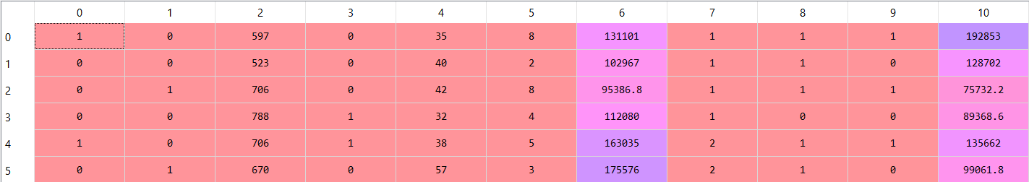
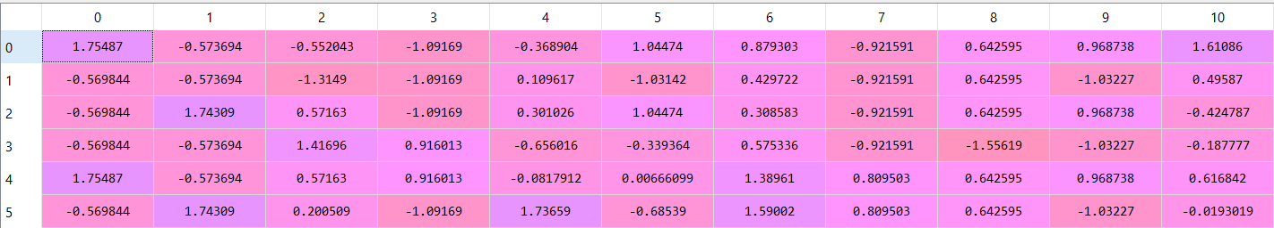
“Scaled data has zero mean and unit variance . . . If a feature has a variance that is orders of magnitude larger than others, it might dominate the objective function and make the estimator unable to learn from other features correctly as expected” (http://scikit-learn.org/stable/modules/preprocessing.html#preprocessing).
# Feature Scaling
from sklearn.preprocessing import StandardScaler
sc = StandardScaler()
X_train = sc.fit_transform(X_train)
X_test = sc.transform(X_test)

Slide 8
There is no rule of thumb on what would be the optimal number of nodes in hidden layers. The number of neurons in the hidden layer might be the mean of the neurons in the input and output layers.
# Importing TensorFlow and the Keras libraries and packages
import tensorflow
import keras
from keras.models import Sequential
from keras.layers import Dense
# Initialising the ANN
classifier = Sequential()
# Adding the input layer and the first hidden layer
## A number of nodes in hidden layers (i.e., units) is (11+1)/2=6
## Initialize the weights as small numbers close to zero
## Use the rectifier activation function (i.e., relu)
## Define a number of input dimensions
classifier.add(Dense(units = 6, kernel_initializer = 'uniform', activation = 'relu', input_dim = 11))
# Adding the second hidden layer
## A number of nodes in hidden layers (i.e., units) is (11+1)/2=6
## Initialize the weights as small numbers close to zero
## Use the rectifier activation function (i.e., relu)
classifier.add(Dense(units = 6, kernel_initializer = 'uniform', activation = 'relu'))
# Adding the output layer
## A number of nodes in output layer (i.e., units) is 1
## Initialize the weights as small numbers close to zero
## Use the sigmoid activation function (i.e., sigmoid)
classifier.add(Dense(units = 1, kernel_initializer = 'uniform', activation = 'sigmoid'))

Slide 9
https://arxiv.org/abs/1412.6980v9
To train our model, we’ll set the learning rate parameter of SGD to 0.01.
For > 2 class labels use crossentropy, but since there are only two class labels, we use binary_crossentropy.
The network is then allowed to train for a total of 100 epochs, meaning that the model “sees” each individual training example 100 times in an attempt to learn an underlying pattern. (https://www.pyimagesearch.com/2016/09/26/a-simple-neural-network-with-python-and-keras)
# Compiling the ANN
##
classifier.compile(optimizer = 'adam', loss = 'binary_crossentropy', metrics = ['accuracy'])
# Fitting the ANN to the Training set
classifier.fit(X_train, y_train, batch_size = 10, epochs = 100)
# Model vizualization
print(classifier.summary())
# Part 3 - Making predictions and evaluating the model
# Predicting the Test set results
y_pred = classifier.predict(X_test)
y_pred = (y_pred > 0.5)
# Making the Confusion Matrix
from sklearn.metrics import confusion_matrix
cm = confusion_matrix(y_test, y_pred)

Slide 10
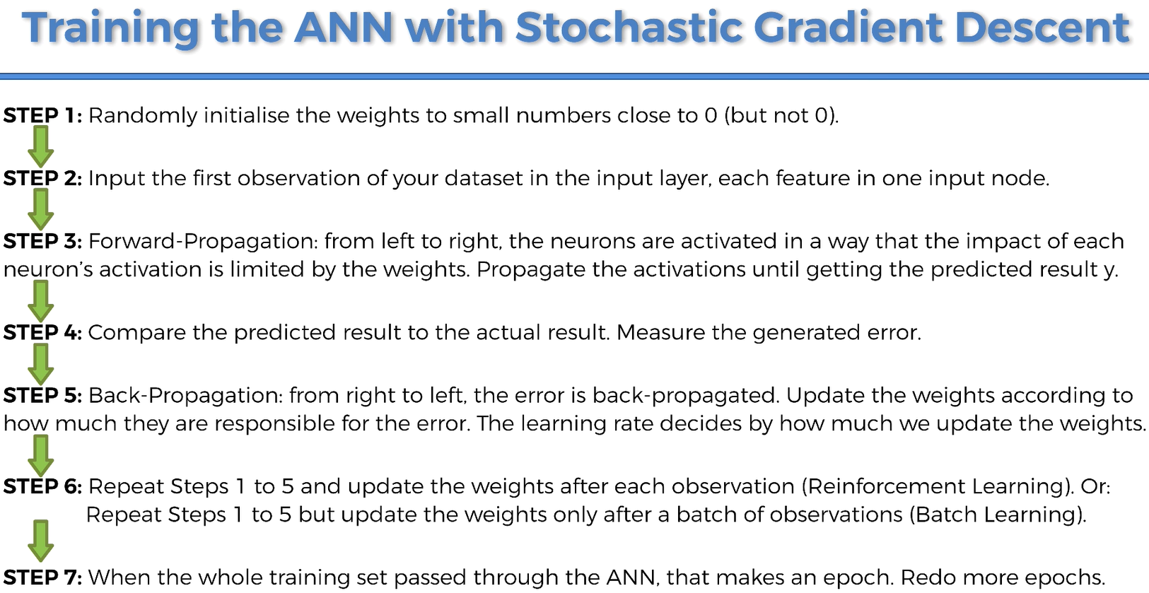

Slide 11
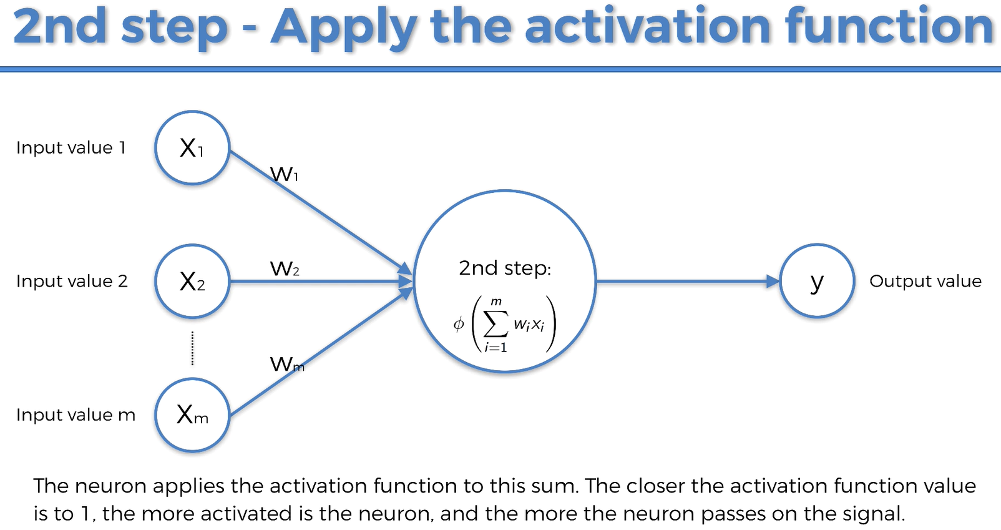

Slide 12
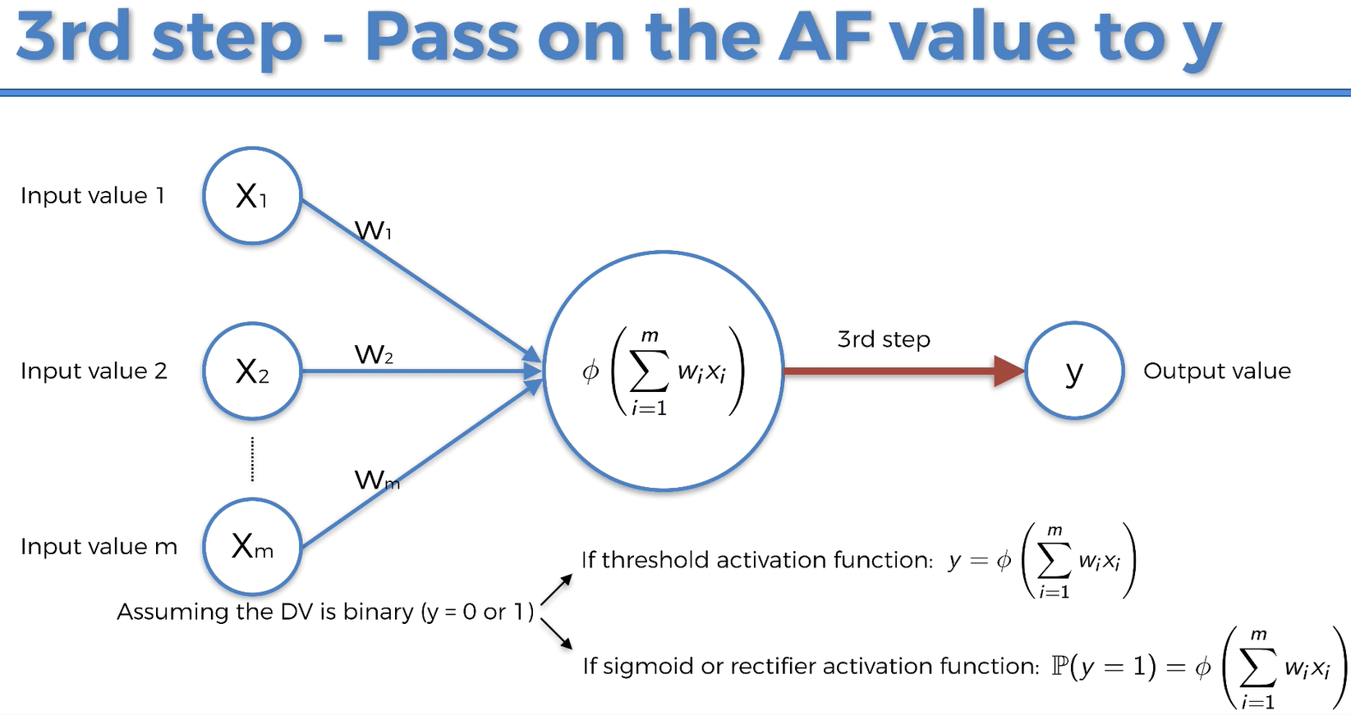

Slide 13
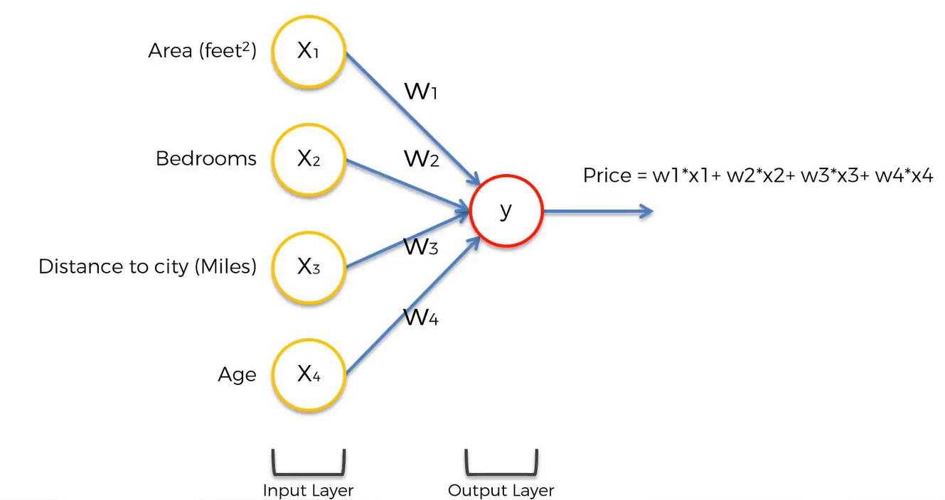
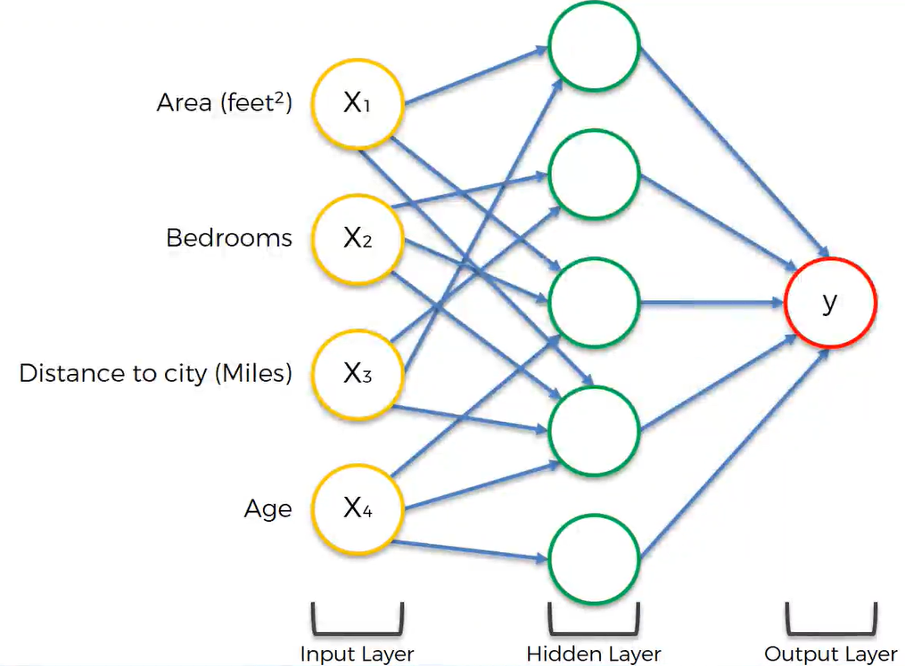
https://www.udemy.com/deeplearning/

Slide 14
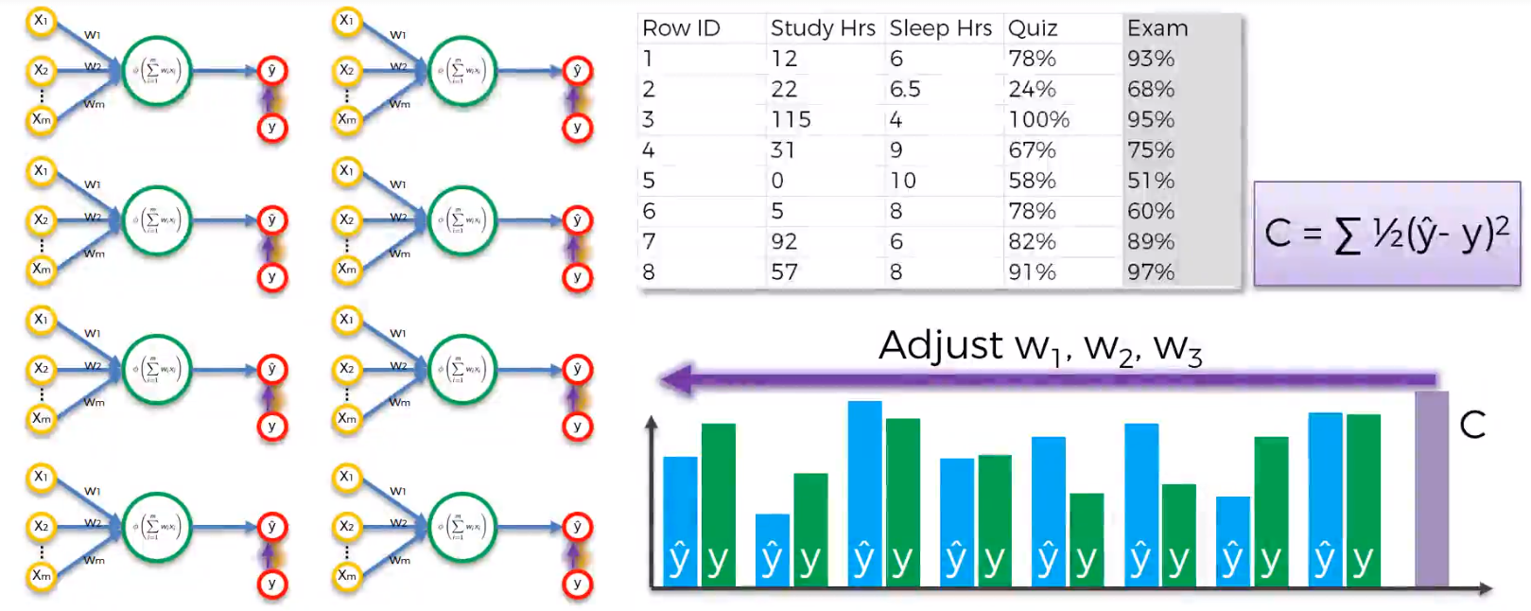
Back propagation
C = cost function
https://www.udemy.com/deeplearning/

Slide 15
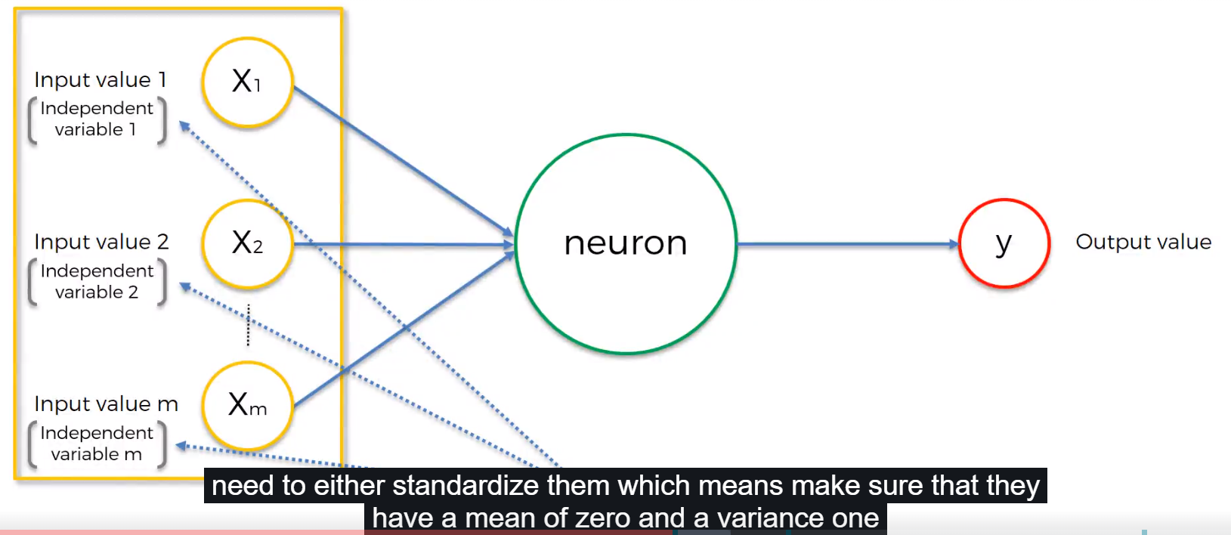
Standardization
https://www.udemy.com/deeplearning/

Slide 16
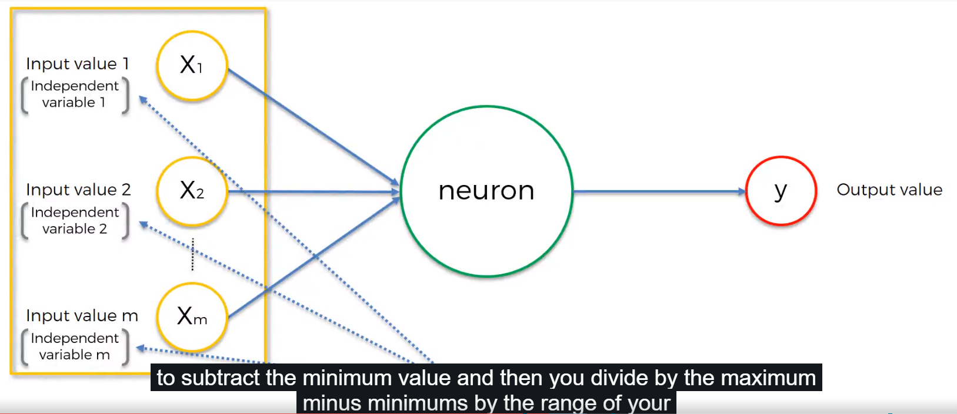
Normalization
https://www.udemy.com/deeplearning/

Slide 17
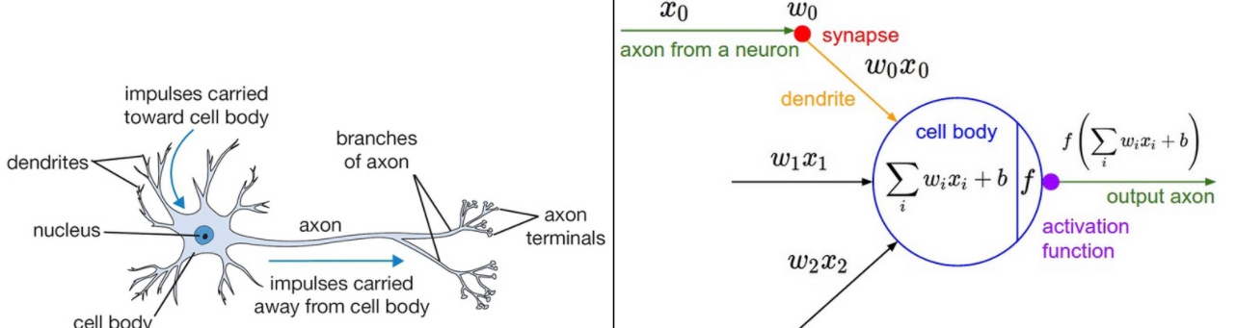
The crucial factors in deep networks is activation functions that brings the non-linearity into networks
Granville. (2016). https://www.datasciencecentral.com/profiles/blogs/must-know-tips-tricks-in-deep-neural-networks

Slide 18
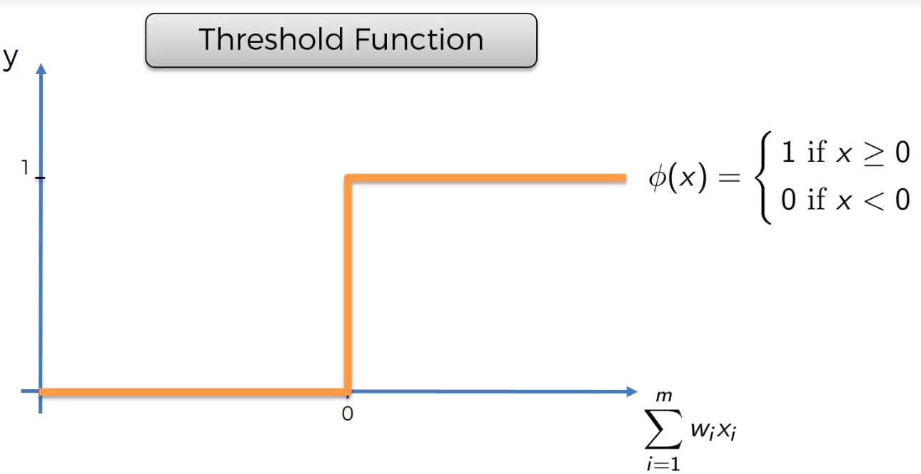
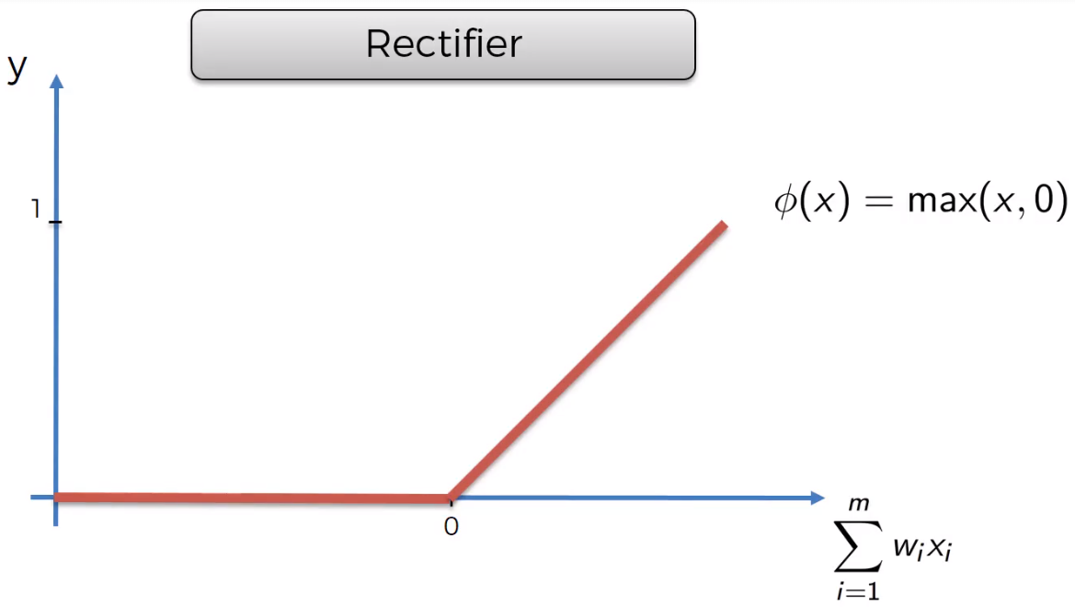
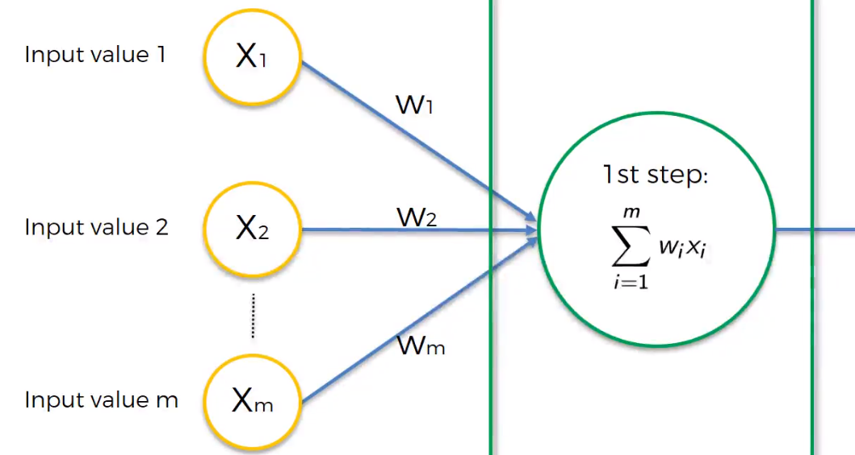
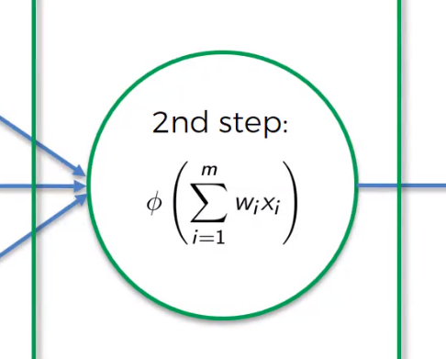
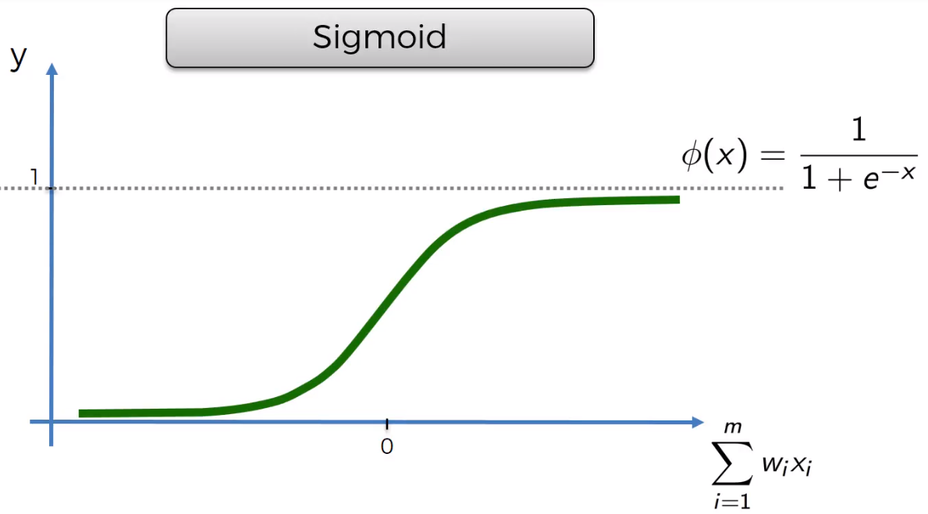
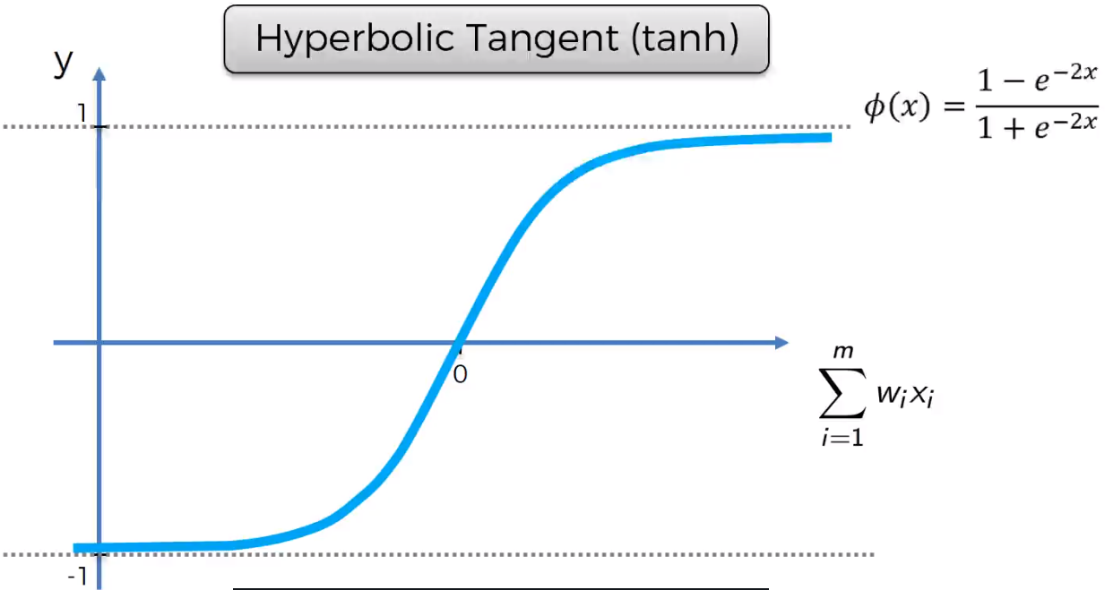
Summarize multiplications
Activation function to pass on (or non pass) a signal
https://www.udemy.com/deeplearning/

Slide 19
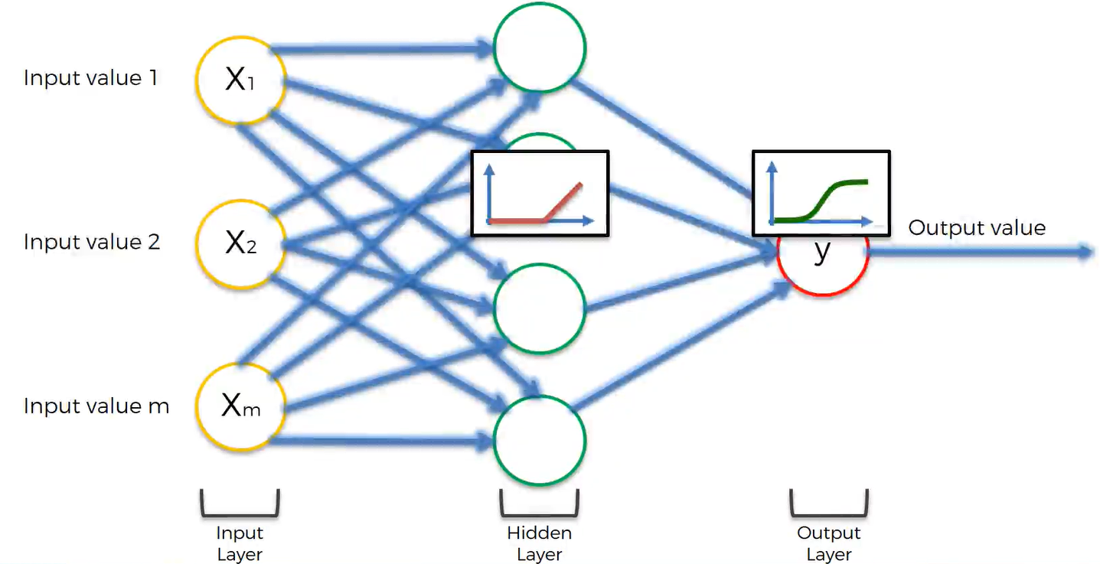
https://www.udemy.com/deeplearning/

Slide 20
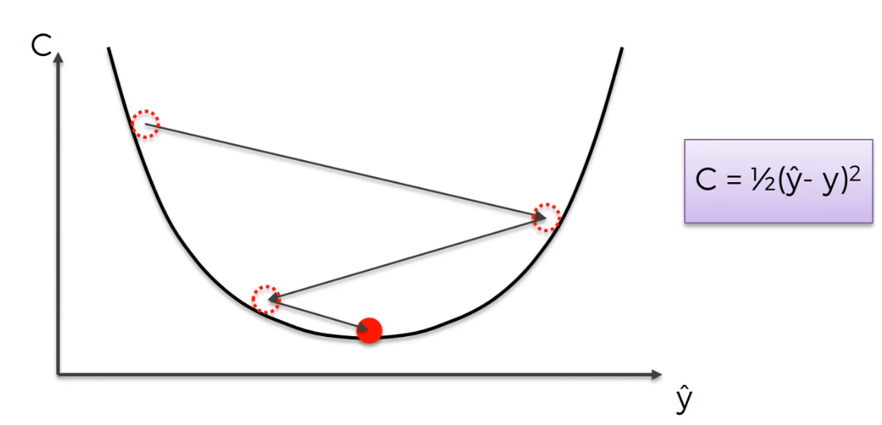
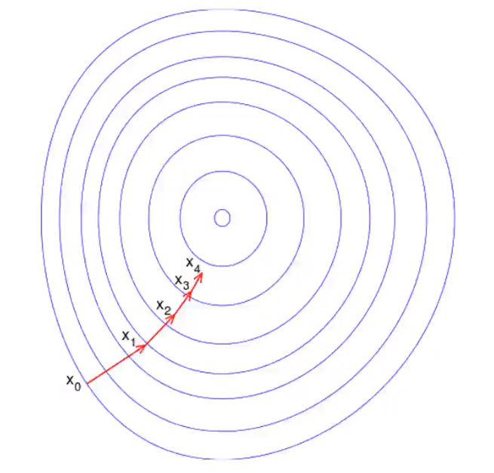
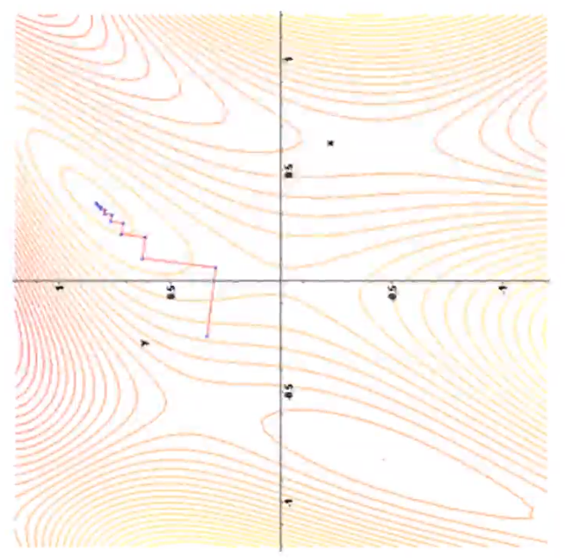
A gradient descent is applied because it is descending into the minimum of the cost function
https://www.udemy.com/deeplearning/
Read more: https://en.wikipedia.org/wiki/Gradient_descent

Slide 21
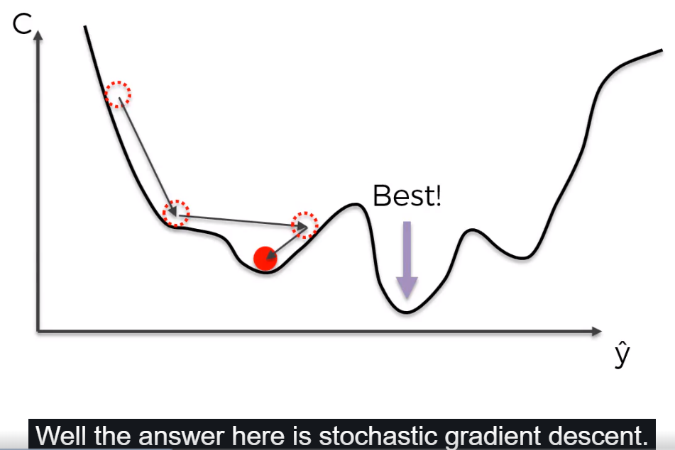
The cost function might not be convex
https://www.udemy.com/deeplearning/

Slide 22
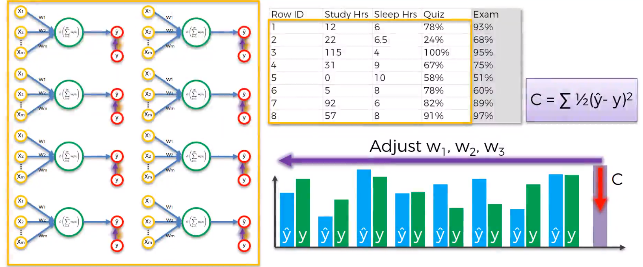
Gradient descent
https://www.udemy.com/deeplearning/

Slide 23
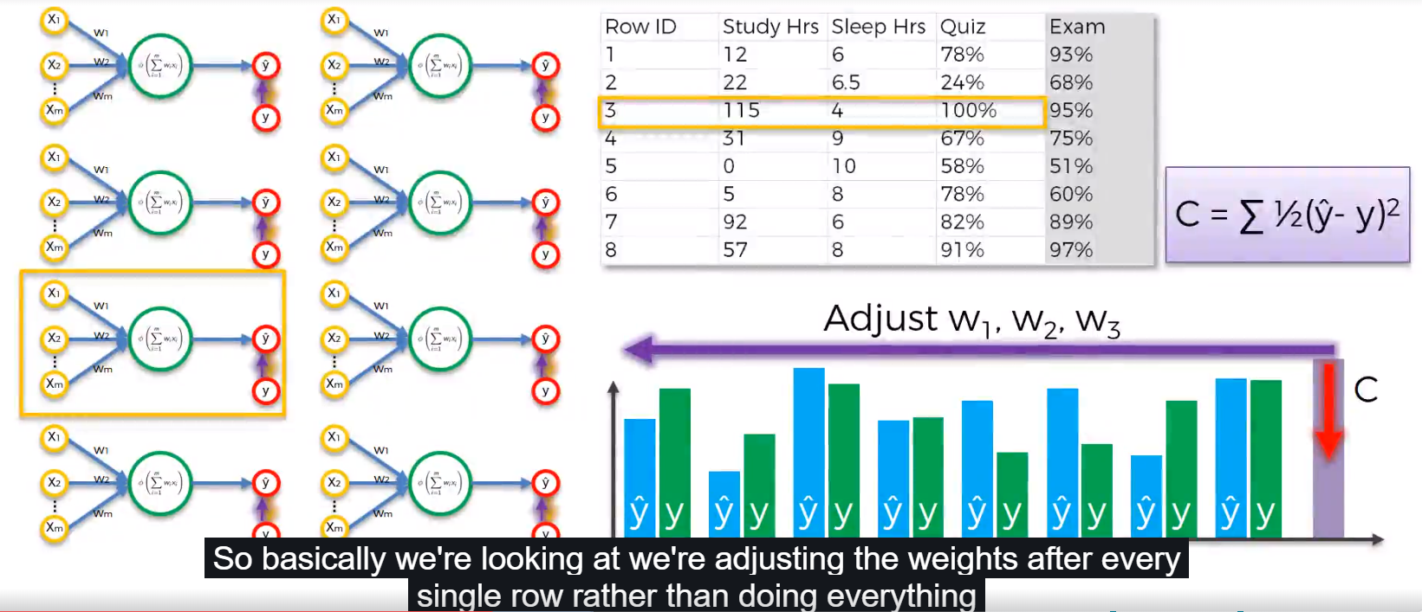
Stochastic gradient descent
https://www.udemy.com/deeplearning/

Slide 24
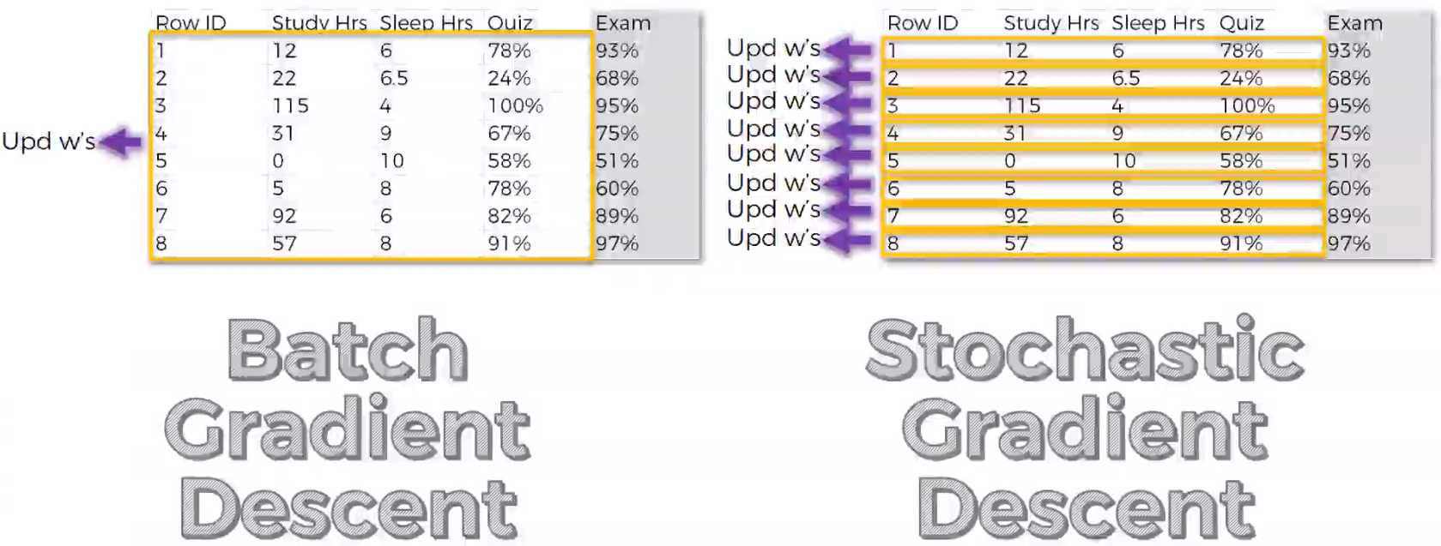
https://www.udemy.com/deeplearning/
Read more: https://www.datasciencecentral.com/profiles/blogs/an-overview-of-gradient-descent-optimization-algorithms =>
http://ruder.io/optimizing-gradient-descent/index.html#tensorflow

Slide 25
A typical machine learning pipeline is as follows:
Data cleaning. The data is prepared “ready for modeling by performing an initial exploratory analysis (e.g., looking for missing or mislabeled data) and either correct or remove the offending records”.
Feature engineering. The data have to transform in some way to make it “more suitable for modeling, e.g., by normalizing the features (i.e., feature transformation), removing features that do not seem useful for modeling (i.e., feature selection), and/or creating new features from the existing data (i.e., feature construction)”.
Model selection and setting (hyper)parameters. A machine learning model is selected “to fit to the data (i.e., model selection) and select the model parameters that allow the model to make the most accurate classification from the data (i.e., parameter optimization)”.
Model validation. The model has to be validated in some way “to ensure that the model’s predictions generalize to data sets that it was not fitted on (i.e., model validation), for example, by testing the model’s performance on a holdout data set that was excluded from the earlier phases of the pipeline”.
Adapted from https://arxiv.org/pdf/1601.07925.pdf

Slide 26
Examples of hyper-parameters are the number k of clusters in k-means clustering, and the dimensions of an artificial neural network (number of hidden layers and number of hidden units). The hyper-parameters must be set before the training step starts. The hyper-parameter settings cause overfitting (i.e., overtraining) or underfitting (i.e., undertraining) which can be reduce, for example, by model validation techniques (e.g., cross-validation) and automated machine learning toolkits such as
PennAI (http://pennai.org/ and https://arxiv.org/abs/1705.00594)
auto-sklearn (http://automl.github.io/auto-sklearn/stable/)
TPOT (https://rhiever.github.io/tpot/).
Source: https://www.ncbi.nlm.nih.gov/pmc/articles/PMC5721660/

Slide 27
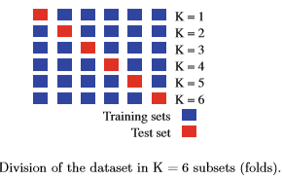
Cross-validation is a sampling statistical technique used to evaluate the ability of generalization of a model
The model’s generalization performance and estimation accuracy depends on a good setting of hyper-parameters.

Slide 28
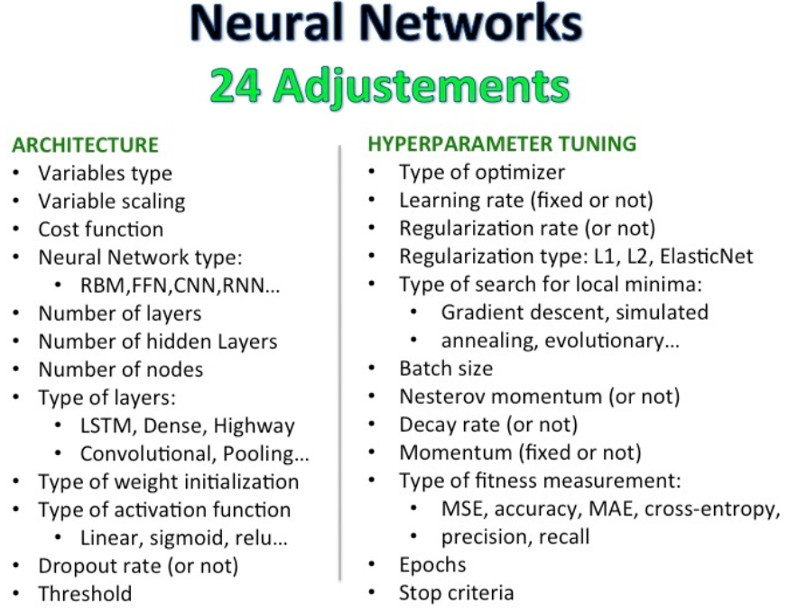
https://www.datasciencecentral.com/profile/RubensZimbres

